Slide 1

API Logging and Monitoring for Security Events
Enhance API security through real-time logging, monitoring, and alerting. This project aims to revolutionize incident response and threat detection in API ecosystems.
Guide : Dr. S Radha
Team Members:
Abburi Bhavya Sri (21R11A05A5)
Kosuru Bharath Kumar (21R11A05C8)
Busholla Srinath (21R11A05B5)

Slide 2
Abstract:
In today's digital landscape, Application Programming Interfaces (APIs) serve as critical components in enabling communication between systems, applications, and services. However, the widespread use of APIs also brings about significant security challenges, as APIs are increasingly targeted by attackers aiming to exploit vulnerabilities. This project focuses on designing and implementing a robust logging and monitoring system tailored specifically for API security. The system aims to track, record, and analyze security-related events within APIs to ensure the detection and quick response to potential threats. By leveraging real-time logging, integration with monitoring tools like Prometheus and Grafana, and setting up automated alerts for suspicious activities, this project aims to create a secure and resilient environment that allows API developers and administrators to proactively manage and respond to security incidents. The goal is to provide a comprehensive solution that not only secures API interactions but also aligns with modern Security Information and Event Management (SIEM) practices.

Slide 3

Project Overview
1
Objective
Develop a robust system for tracking and identifying API security incidents in real-time.
2
Key Features
Implement real-time logging, integrate monitoring tools, and set up automated alerts for suspicious activities.
3
Significance
Ensure proactive API security, minimize threat response time, and align with SIEM standards.

Slide 4
Existing System Challenges
Limited Visibility
Slow Incident Response
Minimal Automation
APIs often lack comprehensive logging, hindering effective security incident tracking and analysis.
Without real-time monitoring, identifying and responding to suspicious activities is significantly delayed.
Current setups frequently lack automated alerts, leading to delayed responses to potential security threats.

Slide 5

Proposed Solution
1
Real-Time Logging
Capture and analyze security-related events as they occur, providing immediate insights.
2
Integrated Monitoring
Utilize Prometheus and Grafana to visualize data, offering clear and actionable insights.
3
Automated Alerting
Configure alerts for specific risk events, notifying administrators instantly of potential threats.
4
SIEM Compliance
Adhere to Security Information and Event Management best practices for comprehensive
security.

Slide 6
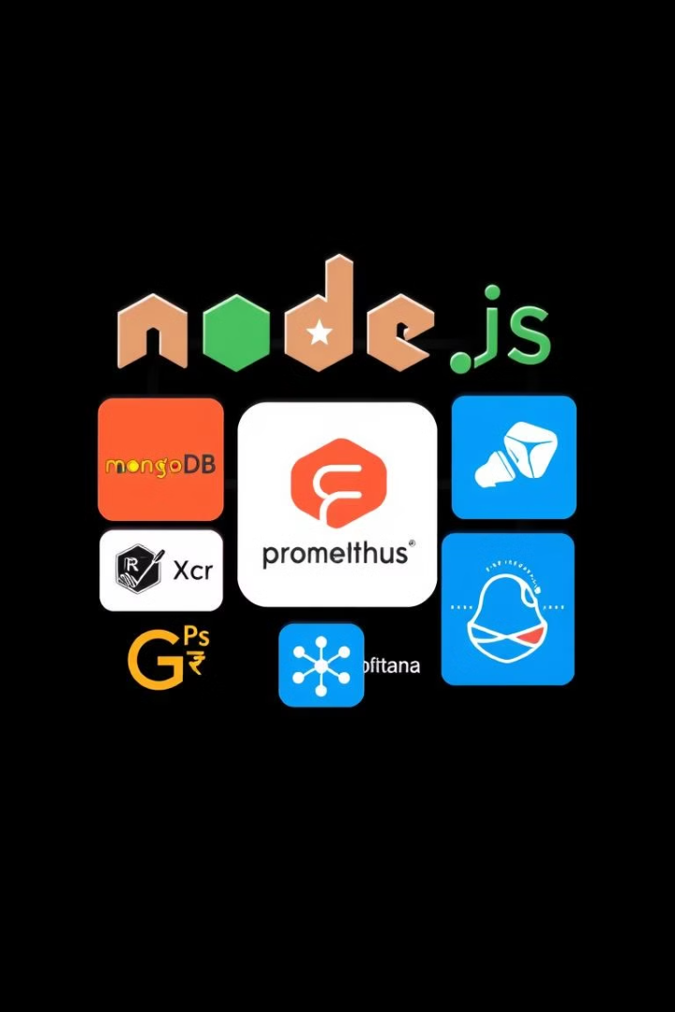




Technologies Involved
Backend
Node.js with Express for building and securing robust APIs.
Database
MongoDB or MySQL for efficient structured data and log storage.
Monitoring
Prometheus and Grafana for collecting metrics and visualizing
real-time data.
Alerting
Configurable alerts integrated with email or Slack for instant
notifications.

Slide 7




API Request Logging
API requests trigger event logging, capturing critical security-related information.
Data Storage and Analysis
Project Workflow
Logs are stored in the database and analyzed by
Prometheus for patterns.
Visualization
Grafana creates intuitive dashboards, offering real-time insights into API security status.
Alert Generation
Specific security events trigger alerts, promptly notifying administrators of potential threats.

Slide 8

Benefits
Enhanced Visibility
Rapid Response
Gain comprehensive insights into API activities, enabling proactive security measures.
Real-time monitoring and alerts significantly reduce incident response times.
Operational Efficiency
Automate security processes, allowing teams to focus on critical tasks.

Slide 9
Thank you !

